Slide 1

Introducing No Outsiders: Preparing Our Children for a Diverse World
Fostering inclusion and understanding in Primary education at Heage
Notes:
AI-generated content may be incorrect. ---

Slide 2
Understanding the Need for Diversity Education
Notes:
Why Are We Talking About This?

Slide 3

Why Are We Talking About This?
Diverse and Interconnected Society
Children will grow up in multicultural communities embracing diversity in race, religion, abilities, and family structures.
Promoting British Values
Schools are required to promote mutual respect and tolerance for different faiths and beliefs as statutory duties.
Benefits of Early Diversity Education
Early teaching about inclusion helps develop empathy, reduces prejudice, and prepares children for future life and work.
Creating Safe and Inclusive Spaces
Diversity education supports safeguarding by creating environments where every child feels valued and accepted.
Notes:
Modern Britain is a diverse and interconnected society, and our children will grow up in communities that include people of different races, religions, abilities, and family structures. Schools have a statutory duty to promote British Values, which include mutual respect and tolerance for those of different faiths and beliefs. Introducing diversity education early helps children develop empathy, reduce prejudice, and prepare for life beyond school. Research shows that children who learn about inclusion and respect at a young age are less likely to engage in bullying and more likely to form positive relationships. This is not about changing personal beliefs but about equipping children with the social and emotional skills to thrive in a multicultural world. By addressing these topics now, we ensure that our pupils are ready for future workplaces and communities where collaboration and respect are essential. This proactive approach also aligns with safeguarding principles, as it helps create a safe environment where every child feels valued and accepted.

Slide 4
What is the No Outsiders Program?
Notes:
Overview of No Outsiders

Slide 5
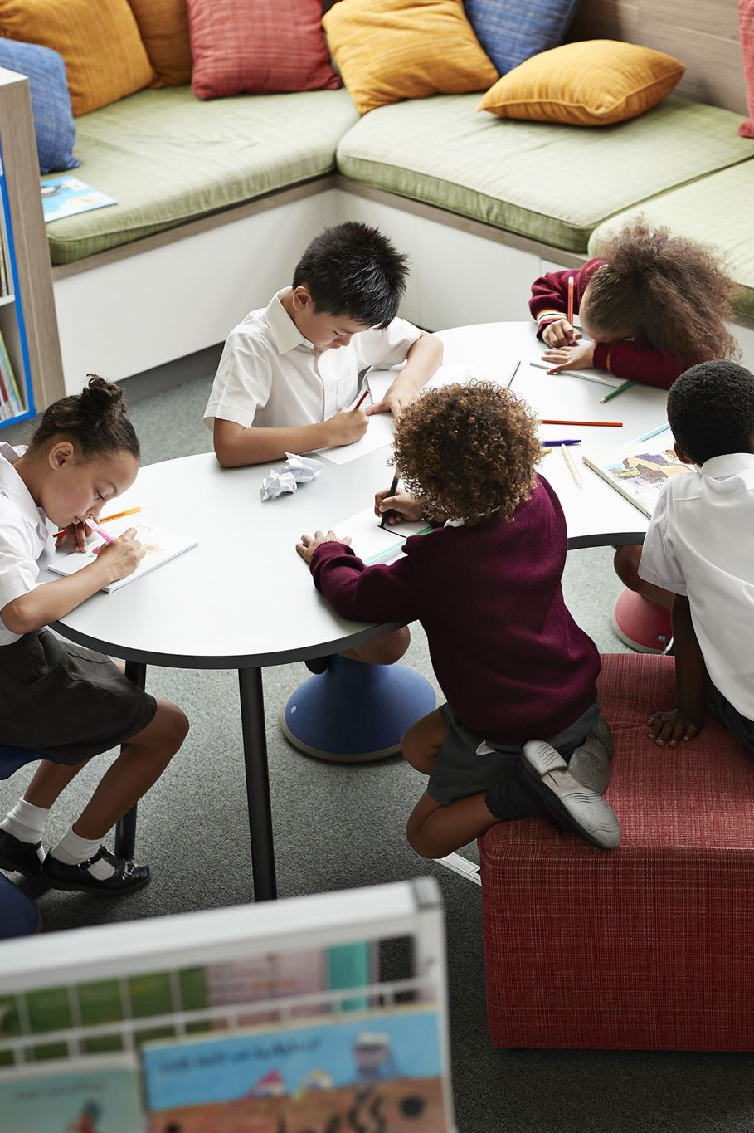
Overview of No Outsiders
Promoting Inclusion and Diversity
No Outsiders fosters respect for diversity and inclusion in primary schools through age-appropriate education.
Curriculum Integration
Lessons are integrated into PSHE and British Values curricula, using picture books and guided discussions.
Empathy and Respect Focus
The program emphasises empathy and respect, creating a safe environment for children to explore differences.
Notes:
No Outsiders is an educational program developed by Andrew Moffat to promote inclusion and respect for diversity in primary schools. It is based on the Equality Act 2010 and uses age-appropriate picture books to introduce children to concepts such as kindness, fairness, and acceptance of differences. The program addresses protected characteristics including race, religion, disability, gender, and family structures, ensuring that children understand that everyone has a place in society. Lessons are short, typically one per half term, and integrated into existing PSHE and British Values curricula. Each session involves reading a storybook followed by guided discussion, allowing children to explore themes in a safe and supportive environment. The approach is evidence-based and designed to be developmentally appropriate, focusing on empathy and respect rather than complex or controversial topics. By embedding these principles into everyday learning, No Outsiders helps create a school culture where every child feels included and valued.

Slide 6
Why Implement No Outsiders Now?
Notes:
The Importance of Early Inclusion

Slide 7

The Importance of Early Inclusion
Early Exposure to Diversity
Children encounter diversity through media, travel, and communities, requiring early preparation for social success.
Benefits of Early Inclusion
Teaching inclusion early builds empathy, resilience, and helps children navigate complex social situations effectively.
Supporting Equality and Values
Early inclusion supports statutory teaching of British Values and equality, preventing stereotypes and prejudice.
Community and Future Impact
Promoting inclusion benefits individuals and communities by fostering harmony and preparing children for diverse societies.
Notes:
Children today are exposed to diversity through media, travel, and community interactions, even if their immediate environment appears homogeneous. Preparing them for this reality is essential for their social development and future success. Introducing No Outsiders now ensures that pupils learn to respect differences before stereotypes and prejudices take root. Early education on inclusion fosters resilience, empathy, and the ability to navigate complex social situations. It also supports statutory requirements for teaching British Values and equality under the law. By starting these conversations in primary school, we help children build a foundation for positive relationships and reduce the likelihood of discriminatory attitudes later in life. This proactive approach benefits not only individual pupils but also the wider community, as it promotes harmony and understanding. Implementing No Outsiders now positions our school as forward-thinking and committed to preparing children for life in a modern, diverse society.

Slide 8
How No Outsiders Will Be Delivered
Notes:
Practical Implementation in School

Slide 9

Practical Implementation in School
Structured Lessons with Picture Books
Short, structured lessons use picture books to introduce themes like kindness, respect, and family diversity.
Guided Discussions and Activities
Children engage in guided discussions and simple activities that reinforce inclusion messages sensitively and age-appropriately.
Parental Transparency and Trust
Parents access book lists and lesson plans to ensure transparency and build trust in the program’s goals.
Teacher Training and School Culture
Teachers receive training to confidently deliver content, fostering a school culture celebrating diversity and belonging.
Notes:
In our school, No Outsiders will be delivered through short, structured lessons integrated into the PSHE curriculum. Each half term, teachers will use a carefully selected picture book to introduce a theme such as kindness, respect, or understanding different families. After reading, children will engage in guided discussions and simple activities that reinforce the message of inclusion. These sessions are designed to be age-appropriate and sensitive, focusing on values rather than personal beliefs. Parents will have access to the list of books and lesson plans to ensure transparency and build trust. The program will complement existing initiatives on British Values and safeguarding, creating a consistent approach to promoting respect and tolerance. Teachers will receive training to deliver the content confidently and respond to questions appropriately. By embedding No Outsiders into everyday practice, we aim to create a school culture where diversity is celebrated and every child feels they belong.

Slide 10
Benefits for Our Children
Notes:
Positive Outcomes of Diversity Education

Slide 11

Positive Outcomes of Diversity Education
Fostering Empathy
Diversity education helps children understand and appreciate different perspectives, building emotional intelligence and healthy relationships.
Building Confidence
It affirms every child's value, teaching that differences are opportunities for growth, enhancing self-confidence.
Promoting Respect
Teaches pupils to disagree kindly and resolve conflicts peacefully, reducing bullying and improving social skills.
Preparing for Diverse Futures
Equips children with skills for future workplaces and communities, fostering responsible and compassionate citizenship.
Notes:
Implementing No Outsiders offers numerous benefits for our pupils. First, it fosters empathy by helping children understand and appreciate perspectives different from their own. This emotional intelligence is critical for forming healthy relationships and succeeding in collaborative environments. Second, it builds confidence by affirming that every child is valued, regardless of background or identity. Children learn that differences are not barriers but opportunities for learning and growth. Third, it promotes respect and reduces bullying by teaching pupils how to disagree kindly and resolve conflicts peacefully. These skills are essential for life in a diverse society and align with our school’s commitment to safeguarding and well-being. Finally, No Outsiders prepares children for future workplaces and communities where diversity is the norm. By equipping them with these competencies early, we set them on a path toward becoming responsible, compassionate citizens who contribute positively to society.

Slide 12
How Parents Can Support
Notes:
Practical Ways to Reinforce Inclusion at Home

Slide 13

Practical Ways to Reinforce Inclusion at Home
Promote Kindness and Fairness
Encourage talking about kindness and fairness in everyday situations like sharing and helping others.
Read Diverse Books
Reading books featuring different cultures and abilities broadens children's understanding and acceptance.
Model Inclusive Behaviour
Parents should show respect for everyone to set an example of inclusion for children.
Engage with School Community
Maintain open communication with school by attending sessions and sharing feedback on inclusion efforts.
Notes:
Parents play a vital role in reinforcing the messages of inclusion and respect taught in school. Simple actions can make a big difference. Start by talking about kindness and fairness in everyday situations, such as sharing toys or helping others. Reading diverse books together at home is another effective way to broaden children’s understanding of different cultures, families, and abilities. Encourage questions and provide honest, age-appropriate answers to help children process new ideas. Model inclusive behavior by showing respect for all people, regardless of differences. Discuss positive examples of diversity in media or community events to normalize inclusion. Finally, maintain open communication with the school—ask to see lesson plans, attend information sessions, and share feedback. By working together, we can create a consistent message that every person is valued and that there truly are no outsiders in our community.

Slide 14
Our Commitment to Inclusion
Notes:
Building a Culture of Belonging

Slide 15

Building a Culture of Belonging
Commitment to Inclusion
The school fosters a safe and respectful environment where every child feels valued and included.
Teaching Diversity Values
Valuing diversity is both a legal duty and moral responsibility preparing students for a global society.
Nurturing Compassionate Learners
Embedding inclusion in the curriculum helps develop confident learners who celebrate differences and kindness.
Parental Partnership
Parents are invited to work together to maintain a welcoming, inclusive school culture for all children.
Notes:
Our school is committed to creating an environment where every child feels safe, respected, and included. The introduction of No Outsiders is part of this commitment. We believe that teaching children to value diversity is not only a statutory requirement but a moral imperative that prepares them for life in a modern, global society. By embedding principles of inclusion into our curriculum, we aim to nurture compassionate, confident learners who celebrate differences rather than fear them. This initiative is about building a culture of belonging—where pupils understand that everyone has a place and that kindness and respect are non-negotiable values. We invite parents to join us in this journey, working together to ensure that our school remains a welcoming space for all. Together, we can make the statement a reality: in our school, there are no outsiders.

Slide 16
PARENT/CARER RESOURCES

Slide 17
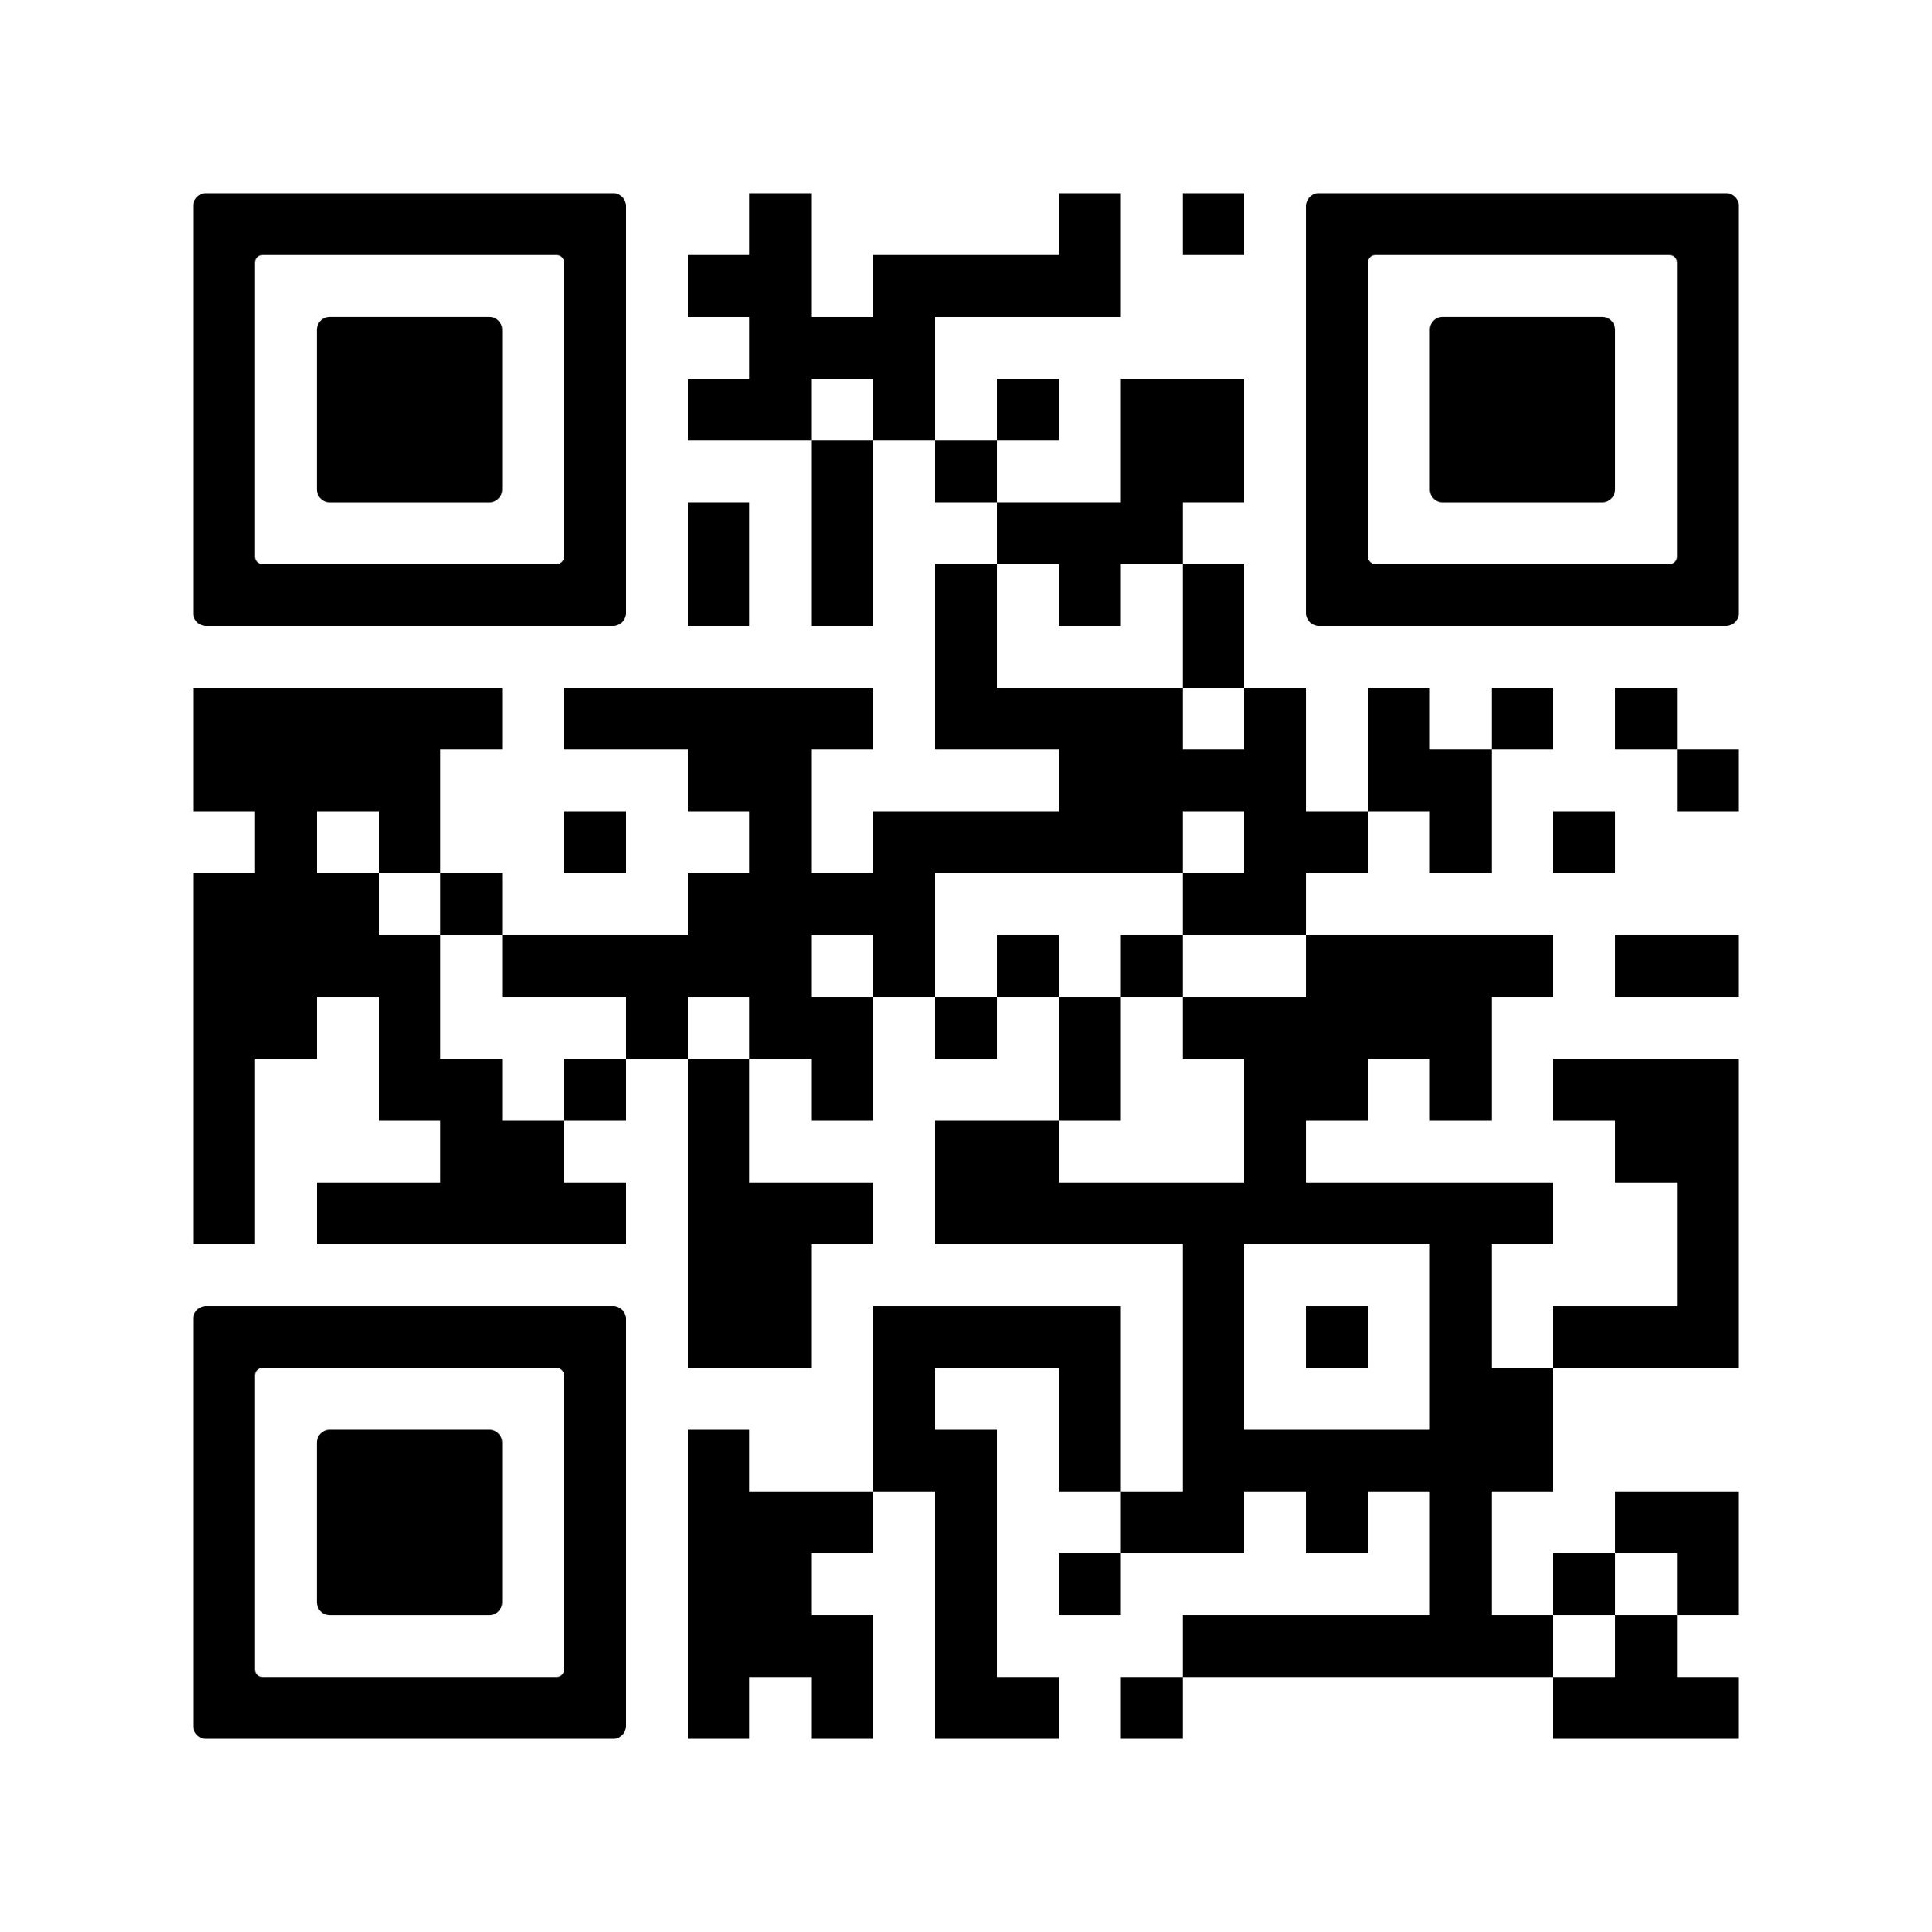
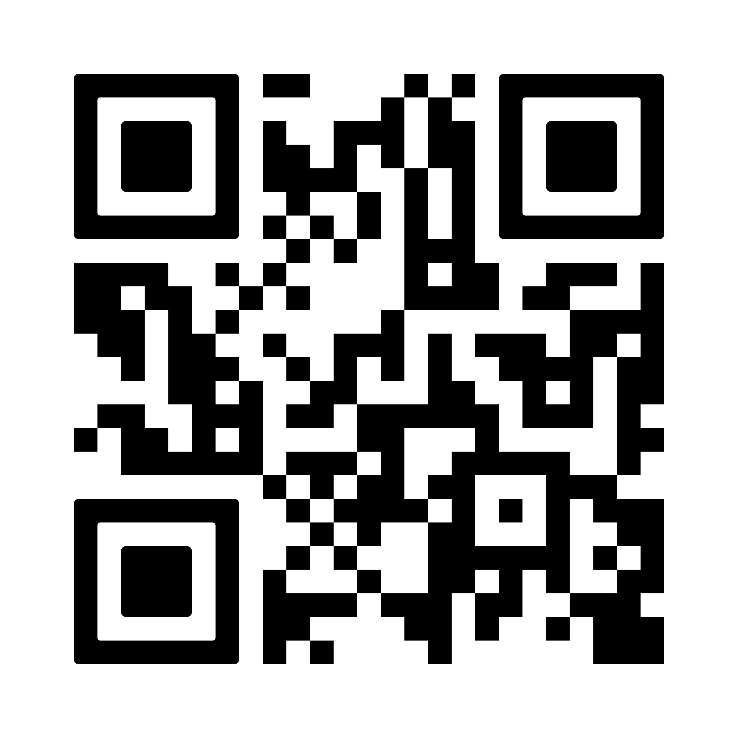
Parent Testimonials/iNFORMATION
Parents and Carers | No-outsiders
Parent and Carer Information
https://no-outsiders.com/parents-and-carers#2619e025-132a-48d7-99bd-79181394f7ff Parent and Carer guide

