Slide 1

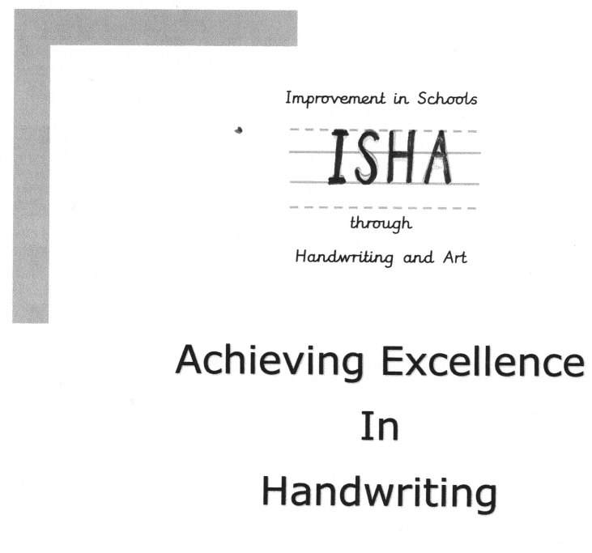
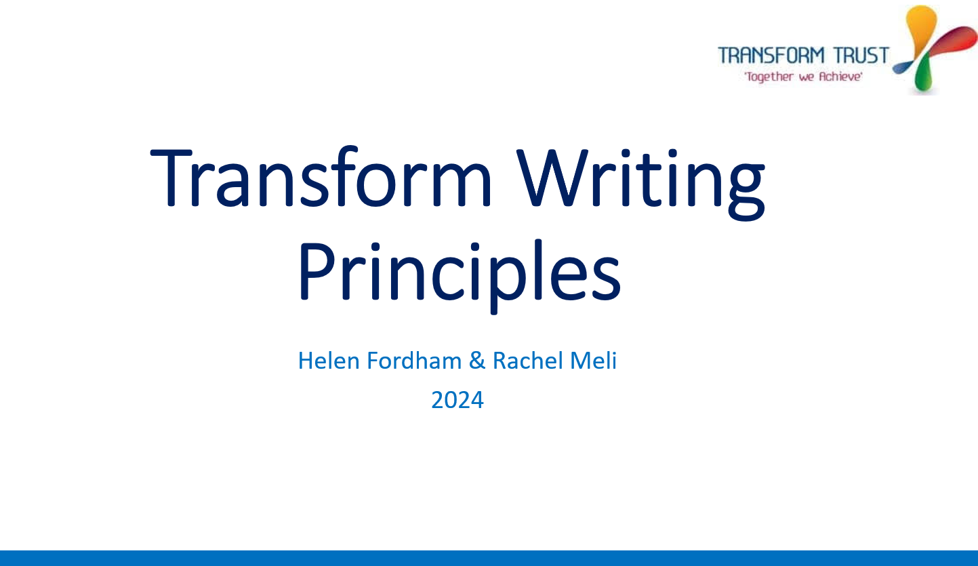
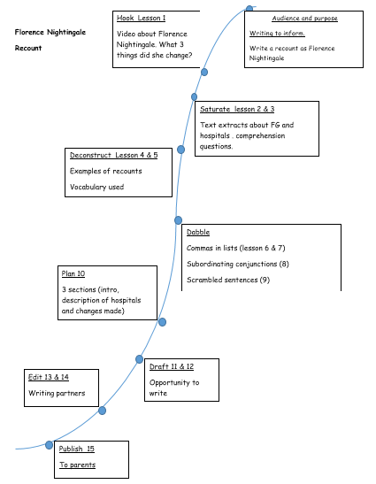
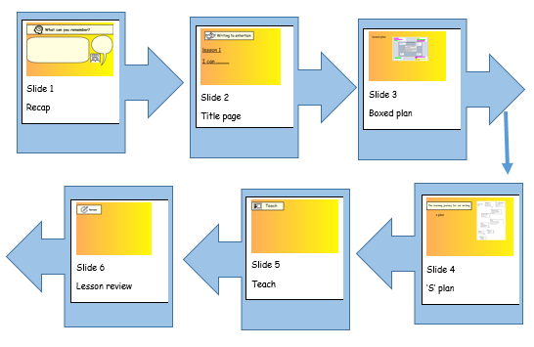
RESPECT, HONESTY, COMPASSION, TEAMWORK, KINDNESS, RESILIENCE
Writing at Heage
Intent Statement
Implementation: Scheme
Implementation: Planning
Implementation: Curriculum links
At Heage Primary School children learn to become independent and confident writers, exploring various genres and curriculum areas. We aim to create a knowledge-rich and engaging curriculum that inspires purposeful writing. By promoting a culture of extensive reading, we help students acquire valuable insights that inform their writing. Teachers model effective writing strategies, equipping children with the skills they need to improve their own work independently. Through this approach, we hope to instill a genuine passion for writing, preparing our children for success in their future challenges.
We approach our writing on the foundations that, the more a child knows and cares about a subject, the more successful their writing will be.
the initial part of a new writing topic is
designed around building knowledge and vocabulary whilst immersing the children in engaging subjects. Each piece of writing has a purpose and an audience. Teachers then plan in the elements of grammar and genre features required in that style of writing, and teach the children to plan their writing effectively. The final element is the drafting and publishing phase, in which we teach the skills of editing and improving before producing the finished article.
All lessons are planned using the Transform Trust Writing Principles. Progression follows that as set out in the National Curriculum for English -EYFS2 (ELG for Writing) to Y6.
Handwriting follows the ‘Achieving Excellence in Handwriting’ scheme by D. Watson (EYFS2 to Y6).
Writing is linked with that term’s topic
or with another area of the
curriculum e.g. science.
Implementation: Resources
Implementation: Lesson Sequence
Implementation: T & L / Pedagogies
Each writing unit has a primary text focus and is supplemented by secondary texts, resourced by the teacher. We used handwriting line guides as detailed in Achieving Excellence in Handwriting – these come in different sizes appropriate to the stage of learning.
During the planning process, teachers will create the following to support children’s learning: Writer’s Toolkit; Boxed up Success Criteria; Checklist; Model Text; Additional Vocabulary, Phrases and Sentences.
• Achieving Excellence in Handwriting
• The Literacy Shed
• Writing conferencing – used to give pupils specific
feedback on a 1:1 basis during the editing process.
• Whole-class feedback – to address common
misconceptions.
• Staff meetings keep all teaching staff informed.
AI generated example texts.
This flow chart shows the sequence of lesson slides for individual writing lessons.
The ‘S’ plan shows the sequence of learning across the writing unit.

Slide 2
Implementation: Environment
Implementation: Feedback
Implementation: How Groups are Supported
(SEND, GDS, PP, disadvantaged, EAL)
English working wall
CEW mats
Grow the code mats
Writing toolkit
Handwriting displayed
Dictionaries/thesaurus
Primary and secondary texts
Marking codes
• Positive praise;
• Self-assessment and peer
assessment against success
criteria;
• Whole class feedback;
• Writing conferences to offer bespoke feedback;
• Writing levelled each term
* Children with additional needs are given targeted and bespoke
support including sometimes using digital adaptations.
• Those children for whom phonics hasn’t worked (or isn’t working)
take part in interventions with fully trained teaching staff.
• Formative and summative assessments inform next steps for
highlighted individuals and groups.
• Quality first teaching strategies to support all learners.
•
Impact: Evidencing
Impact: Assessment
Impact: Monitoring
Any work leading up to the publishing element of each unit is recorded in independent writing
books. These books are to be used for practising any skills, planning and drafting with the published pieces being the final, perfect article.
Published pieces are displayed to be enjoyed by
others.
The writing unit (initial planning stage)
and each set of lesson slides are evidence of
learning.
Independent writing books are used to keep
a record of children’s writing progression.
• Formative assessments identify progress and inform next steps.
• Termly summative assessments to give a
writing level (WB, WTS, EXS or GDS) using
TA
Y2 and Y6 use DfE End of Key Stage Teacher Assessment Frameworks (TAFs).
• School moderation of writing at
networks and within school.
Lesson slide reviews – does what is
recorded on the writing unit
mirror what is on individual lesson
slides?
Book-looks
Lesson observations and drop-ins
Pupil voice

