Slide 1

Welcome to
Heage Primary School
Notes:
Intro

Slide 2
Welcome to FS2 (Froggatt)
Starting school is exciting but can bring questions.
This meeting will help you feel confident and informed.
Notes:
DONNA

Slide 3
Meet the Team
Headteacher – Mrs Hallam
Deputy Head – Mrs Roberts
SENCO – Mrs Lane (works on a Wednesday and Thursday)
FS2 Lead – Mr Stevenson
FS2 TA’s – Mrs Miller (am) Mrs Morley (pm)
Notes:
DONNA

Slide 4
Vision and Values
Kindness, Honesty, Resilience, Teamwork, Compassion and Respect.
Having a safe and inclusive environment that challenges our children and allows them to make mistakes.
Our children being individuals whilst also gaining knowledge and acquiring an understanding of the diverse world we live in.
Creating leaders of the future.
The strength in Pupil Voice.
Working in partnership with home so our children be the best versions of themselves now and in the future
Notes:
DONNA

Slide 5
What to Expect In the First Week
INSET DAYS – 4th and 7th September (To Be Confirmed)
First Day – Tuesday 8th September. Gates open at 8.45am and close promptly at 8.55am. Parents can, and are encouraged in FS2, to walk their child round to the FS2 gate. You will met by either Mrs Stevenson or Mrs Miller who will walk your child into class. At the end of the day the main gates will open at 3.15pm and you will need to walk round to collect your child.
Daily routine overview –
Arrival and entry activity – the children do an emotional check-in and choose an activity
Registration – the children all sit on the carpet together and say good morning
Morning session (including time for snack) - with a balance of adult-led and child-initiated activities, inside and outside
Lunch time in the Hall – the Froggatt class children all sit together for lunch (even if they bring a packed lunch)
Afternoon session – we do an afternoon registration, then there will be more adult-led and child-initiated activities, inside and outside
End of the day – we finish with a story all together on the carpet, with a review of the day and a look ahead to the next day
Notes:
DONNA and James – daily routine

Slide 6
Lunch arrangements – all children in FS2 are entitled to a free school meal – cooked on site and provided by DCC.
If you child brings packed lunches they will still sit with their peers. We have a serious allergy in school and therefore we are a pea and nut free school. This includes nuts, peanuts, chickpeas, Nutella, lentils, peas and hummus.
Notes:
DONNA

Slide 7
A Day in Reception
• Typical daily routine
• Drop-off and collection procedures
• First day arrangements
• Lunchtime and snacks
Notes:
JAMES

Slide 8
What Children Learn
Overview of the Reception curriculum
Play-based learning explained
Phonics and early reading
Early maths
Notes:
JAMES

Slide 9

A new theme each half-term.
Provides inspiration for learning, uses high-quality texts, links to visits and visitors.
What
Children
Learn​
Notes:
JAMES

Slide 10
7 Areas of Learning
3 Prime Areas (these support all other learning)
Communication and Language
Talking, listening, understanding
Physical Development
Movement, coordination, fine and gross motor skills
Personal, Social and Emotional Development
Confidence, relationships, managing feelings
Reception
Curriculum
4 Specific Areas (These build on the prime areas)
Literacy – Reading and writing
Mathematics – Numbers, patterns, problem-solving
Understanding the World – People, places,
technology, nature
Expressive Arts and Design – Art, music, role play,
imagination
Notes:
JAMES

Slide 11
Children learn important skills while playing, exploring, and following their interests.
Play-Based Learning
Child-led or guided – children choose activities or adults gently guide learning
Active and hands-on – using toys, materials, role play, and movement
Fun and engaging – learning feels enjoyable, not forced
Linked to real experiences – children explore things they see in their world
Notes:
JAMES

Slide 12

Phonics and Early Reading
Our goal: confident, fluent readers
who enjoy books!
We use Little Wandle to teach phonics daily.
Children learn to hear sounds, blend them to read words, and segment them to spell.
Books are carefully matched to your child’s phonics stage so they can build confidence and read successfully.
We re-read books in school to develop fluency, expression, and understanding.
Notes:
JAMES

Slide 13

Early
Maths
We use White Rose Maths to build strong early number skills through play, exploration, and practical activities.
Children develop a deep understanding of numbers by counting, comparing, and exploring patterns.
Learning is taught in small steps to help children feel confident and successful.
We use songs, stories, and hands-on resources to make maths fun and meaningful.
Our goal: confident mathematicians
who enjoy exploring numbers
and patterns!
Notes:
JAMES

Slide 14
Supporting at Home
• Helping with reading and phonics
• Supporting early maths skills
• Resources and guidance from school

Slide 15
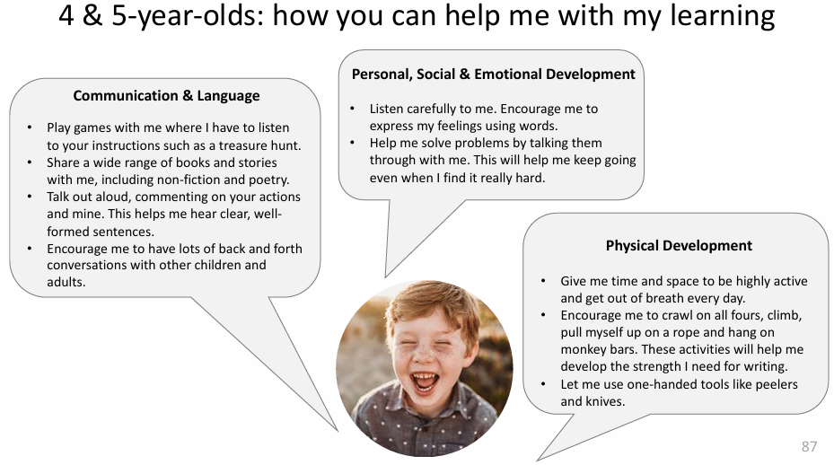
Play-Based Learning
What to expect in the Early Years Foundation Stage: a guide for parents The East London Research School
Notes:
JAMES

Slide 16
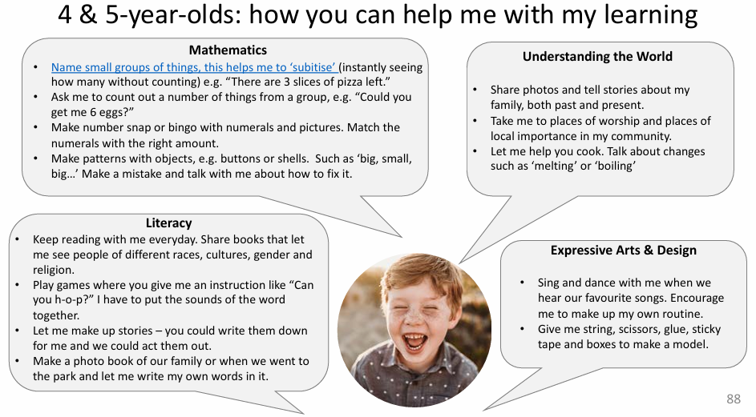
Play-Based Learning
What to expect in the Early Years Foundation Stage: a guide for parents The East London Research School
Notes:
JAMES

Slide 17
Relational Behaviour Policy
To create an ethos of high-expectations
To ensure high-quality classroom practice
To ensure all children feel safe, physically and emotionally.
To ensure expertise in relational and restorative practices, reflection and personalisation.
To create attachment-aware approaches to exploring the reasons why children may display distressed behavior and developing strategies to address this.
To deliver high-quality behaviour interventions for SEND children and develop appropriate strategies to support children requiring further support.
Notes:
LINDSEY

Slide 18
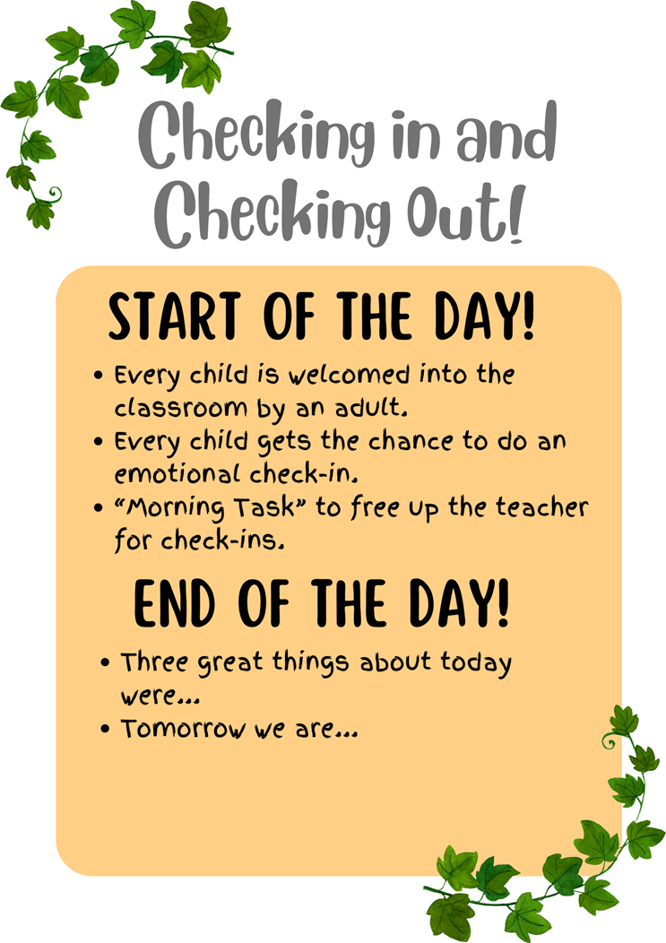
Building Relationships
Notes:
LINDSEY

Slide 19

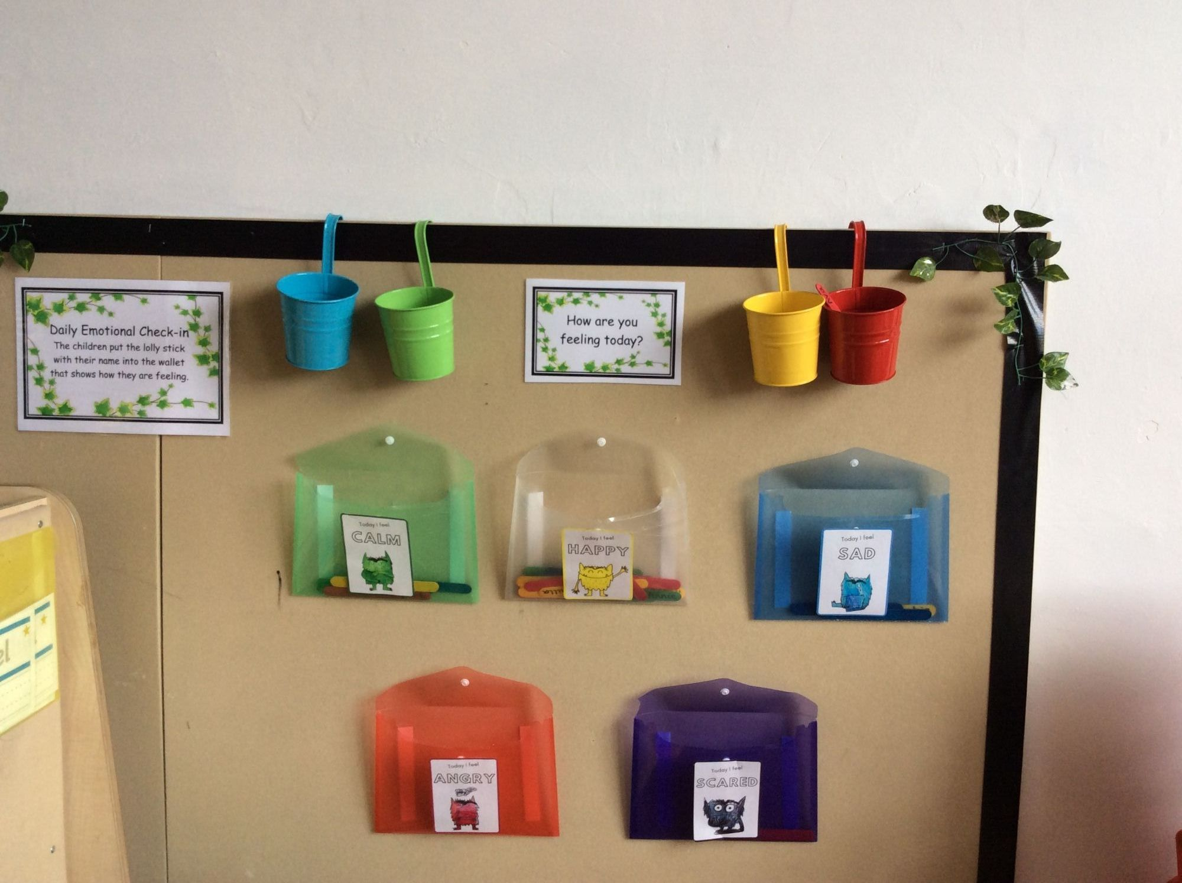
Wellbeing & Behaviour
• Supporting children to settle
• Behaviour expectations
• Supporting friendships and confidence
Notes:
DONNA/LINDSEY

Slide 20
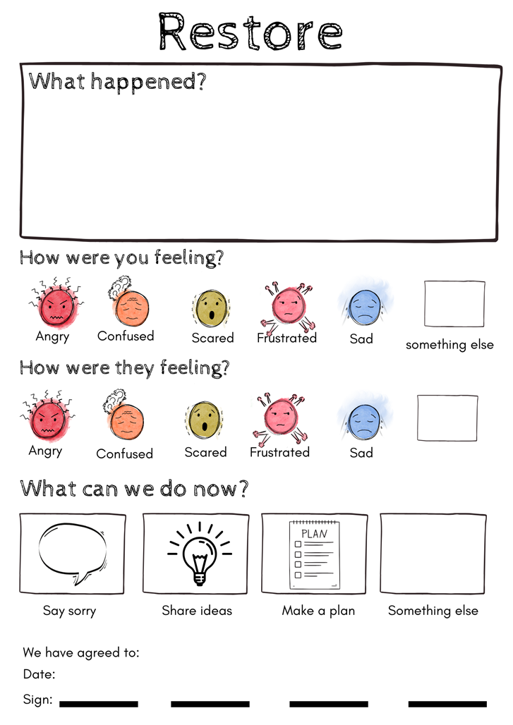
Notes:
LINDSEY

Slide 21
Safeguarding and Wellbeing
DSL (Designated Safeguarding Lead) – Donna Hallam
Deputy Designated Safeguarding Leads – Mrs Roberts, Mrs McAnulty and Mr Stevenson
Key policies can be found on the school website
Mrs McAnulty is our Senior Mental Health Lead within school.
Mrs Lane is our SEND Lead and works on a Wednesday and Thursday.
Notes:
DONNA

Slide 22
Independence Skills
• Toileting expectations
• Dressing and self-care
• Encouraging independence
Notes:
JAMES

Slide 23
Staffing & Support
• Adults in the classroom
• How support is structured
• Ensuring quality interactions
Notes:
JAMES

Slide 24
Communication
• How school communicates with parents
• Who to speak to and when
• Raising concerns
Notes:
DONNA

Slide 25
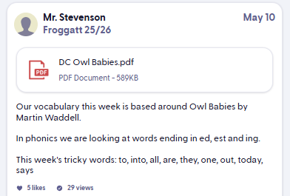
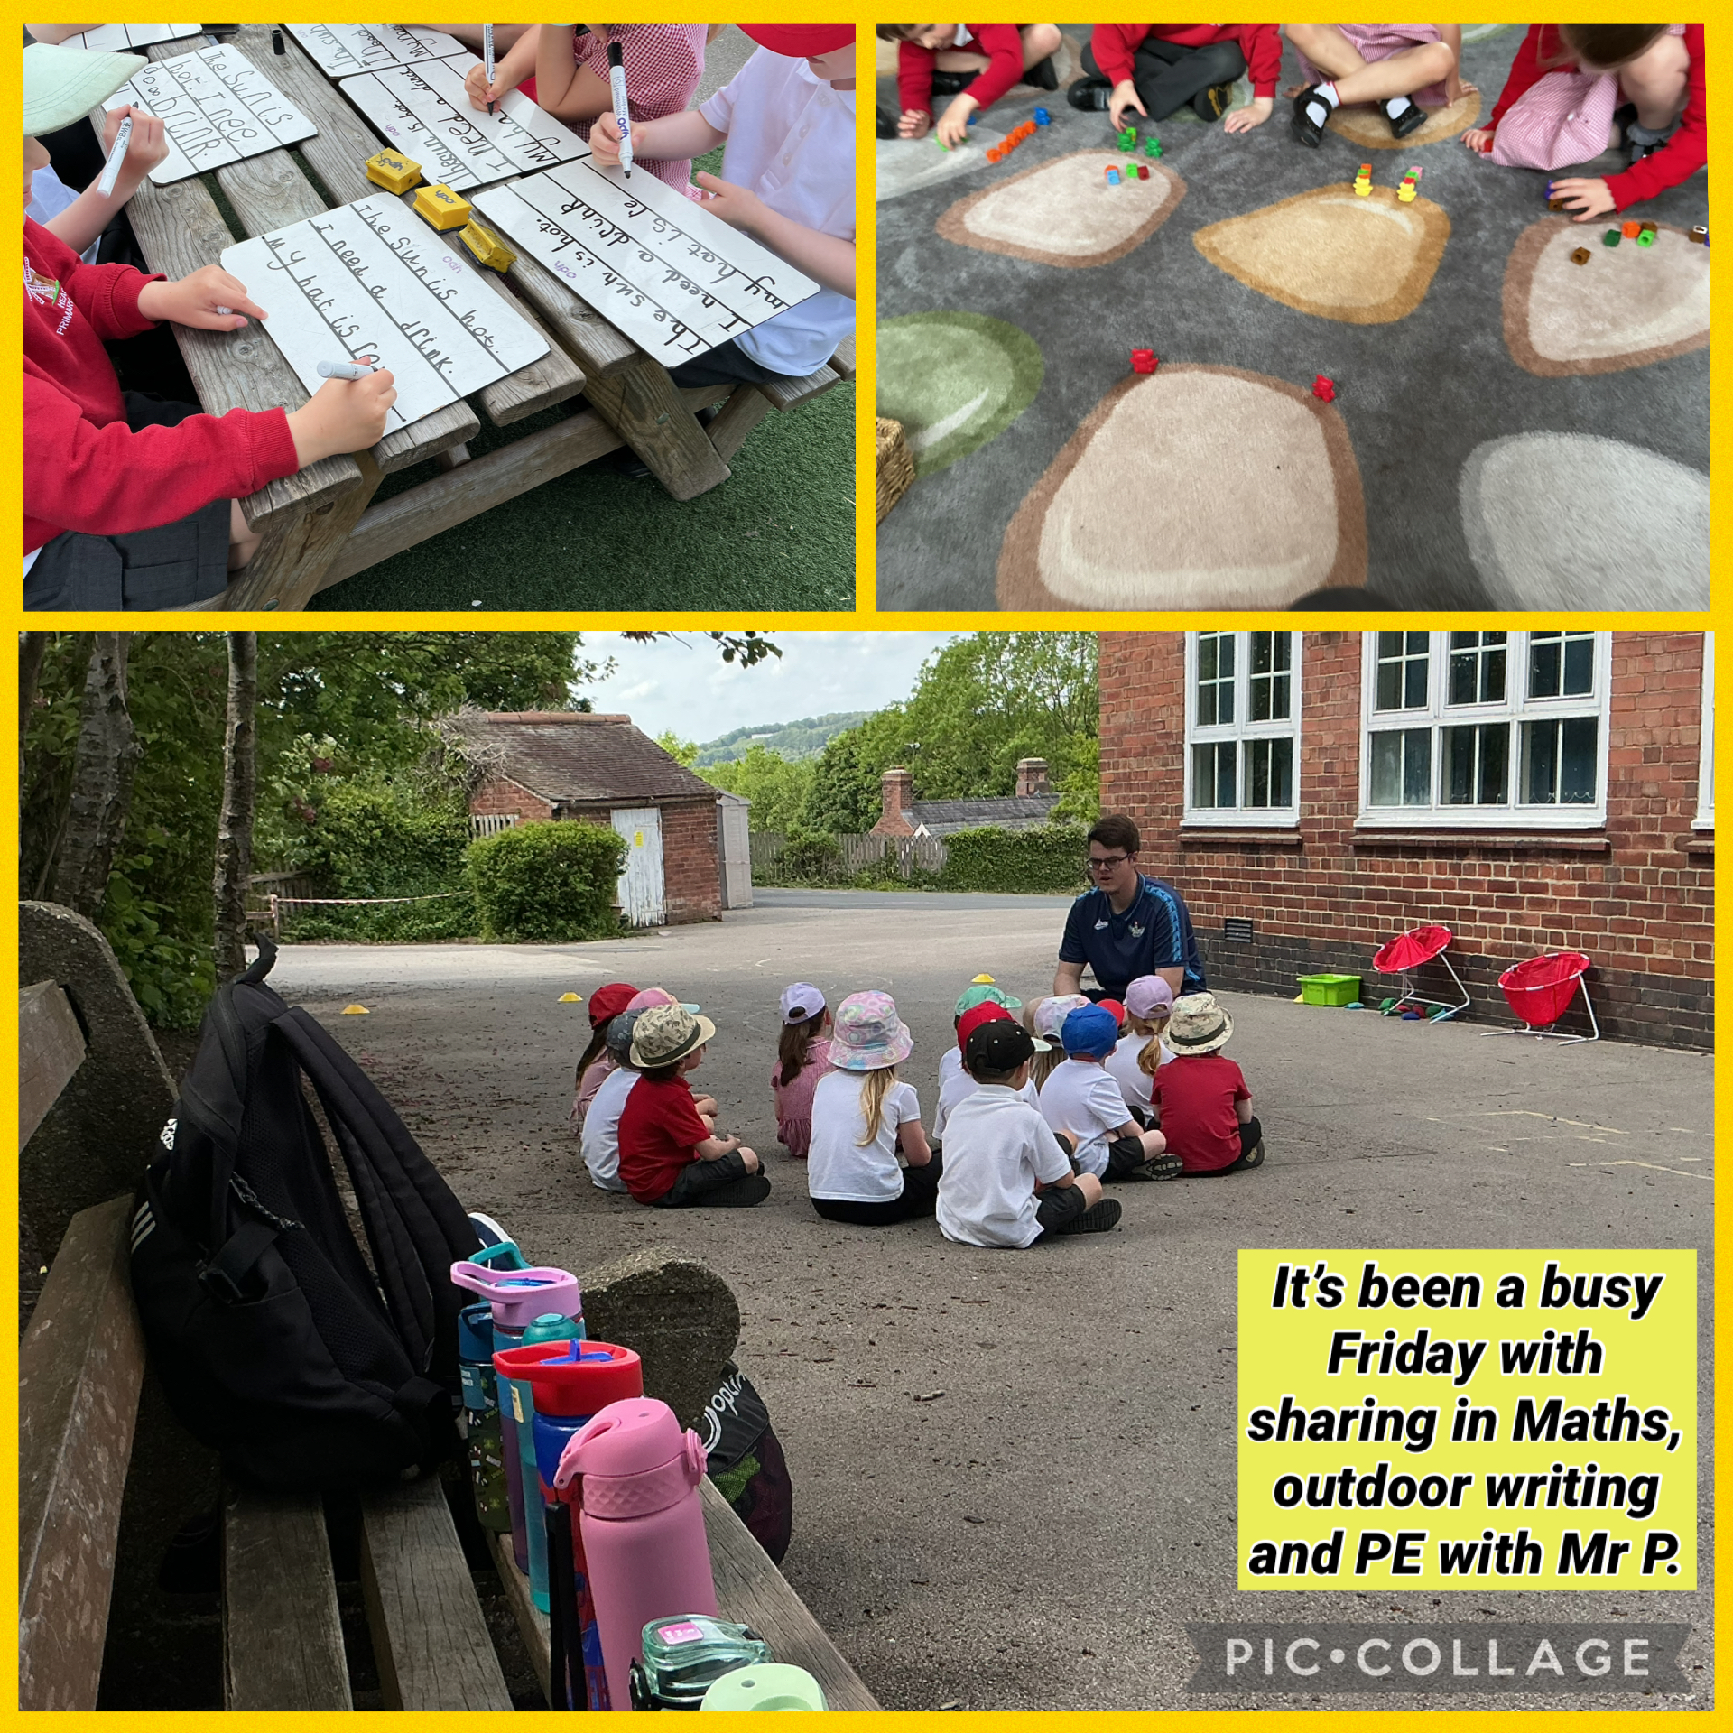

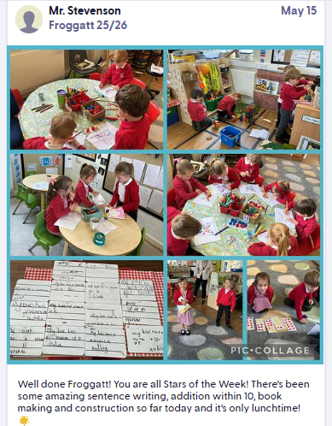
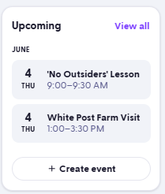
ClassDojo
We use ClassDojo to help parents/ carers be more involved
in their child’s learning by sharing classroom activities, announcements, and celebrations.
Notes:
DONNA

Slide 26
Additional Support
SEND support and SENCo – information in FAQs and also on the website.
Notes:
DONNA

Slide 27
The Base
You will find lots of information in the brochure and on our website.
Miss Evans – Base Manager
Excellent links with school
Themed activities
Breakfast/Light Tea
Communication with school
Contract and registration form from the office on Transition Days
Notes:
DONNA

Slide 28
Practical Information
• Uniform
• PE
• PTFA
• Start dates and key information
Notes:
DONNA

Slide 29
Transition Days
Information has been sent to you regarding Transition Days on the 23rd, 24th and 25th June – please let us know if you did not receive this as we may have the wrong contact information for you.
23rd June - A group = morning and lunch
B group = afternoon
24th June - B group = morning and lunch
A group afternoon
25th June – A and B group just morning (no lunch)
Notes:
DONNA

Slide 30
Questions
We are here to help—please ask anything you are unsure about.
Notes:
ALL

